Slide 1
Using Alpheios
For Reading and Word Study
Bridget Almas
SunoikisisDC 2018-2019
January 17, 2019
@Alpheios
@BridgetAlmas

Slide 2
What are the Alpheios Reading Tools?
Tools for making learning and reading classical texts as efficient and enjoyable as possible
Currently manifested as
Browser Extensions (Chrome, Safari and Firefox)
Embeddable javascript library

Slide 3
What do they do?
Enhance any text you read in the browser with clickable access to:
dictionary entries
morphological analyses
inflection tables
grammars
Latin and Ancient Greek are fully supported
Partial support for Classical Arabic and Persian

Slide 4
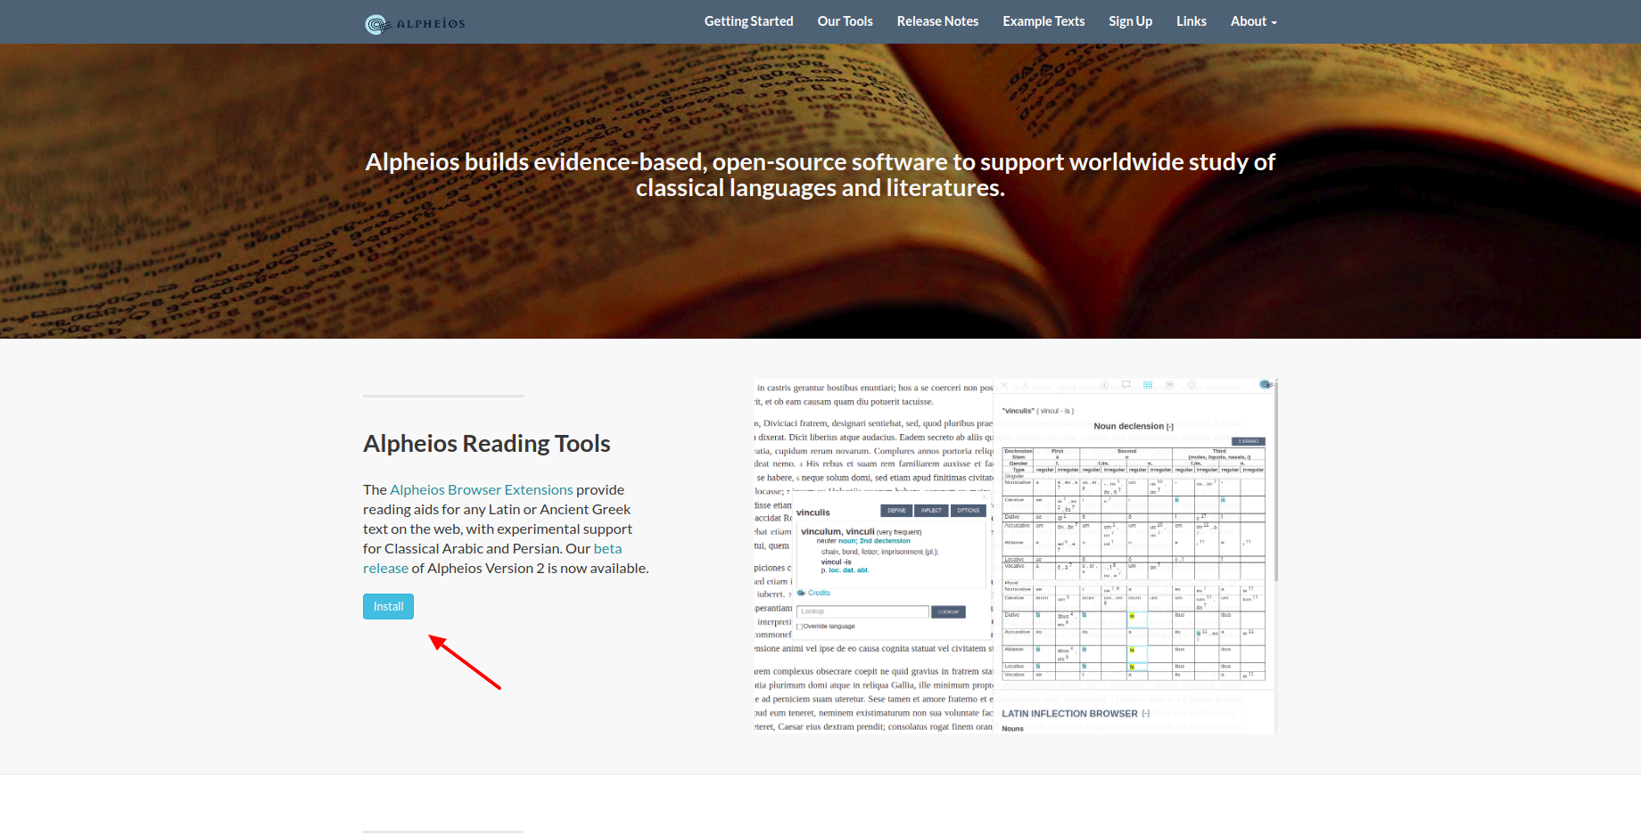
Installation (https://alpheios.net)

Slide 5
Installation (direct links)
Chrome: https://chrome.google.com/webstore/detail/alpheios-reading-tools/apkmkeppocbbebomnhdmhfenfifkhjfd
Firefox: https://addons.mozilla.org/en-US/firefox/addon/alpheios-reading-tools/
Safari: https://itunes.apple.com/us/app/alpheios-reading-tools/id1446884649

Slide 6
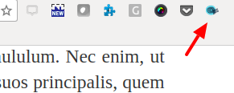
Navigate to any page and Activate
E.g. http://thelatinlibrary.com

Slide 7
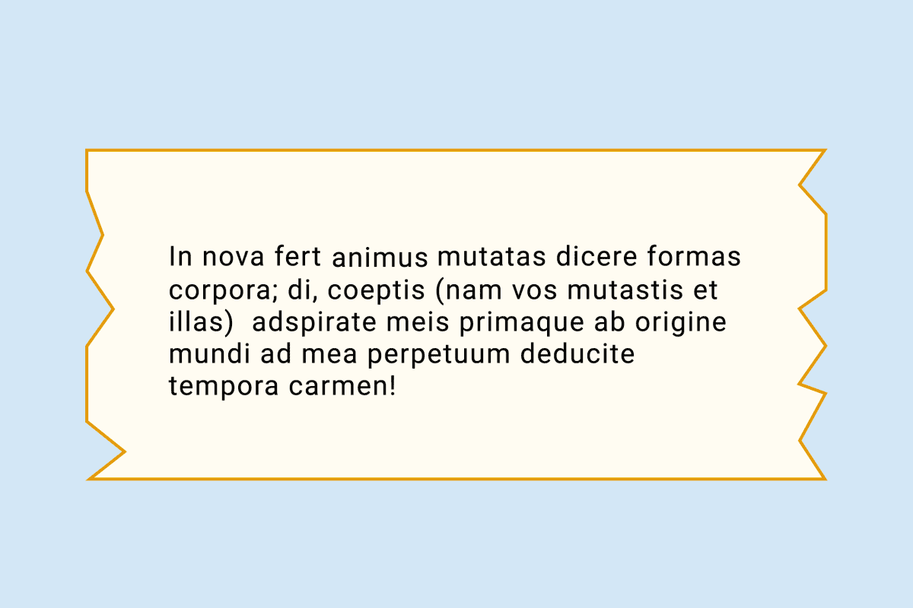
Double-Click on a Word

Slide 8
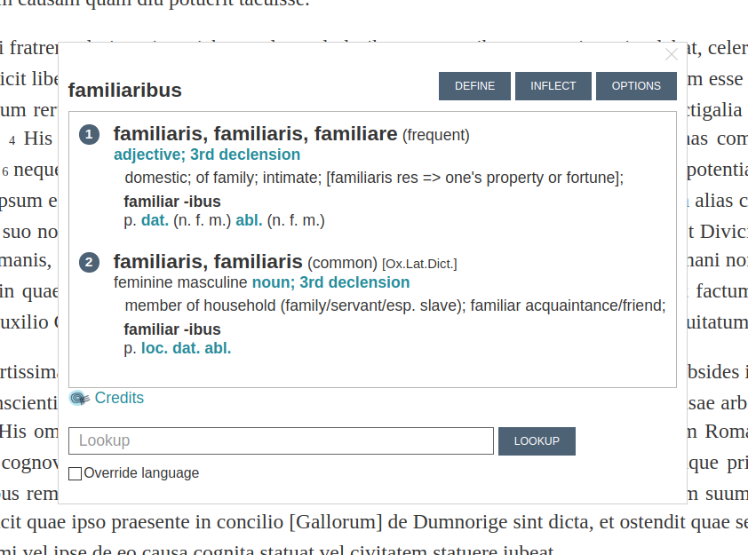
View Morphology and Short Definitions

Slide 9
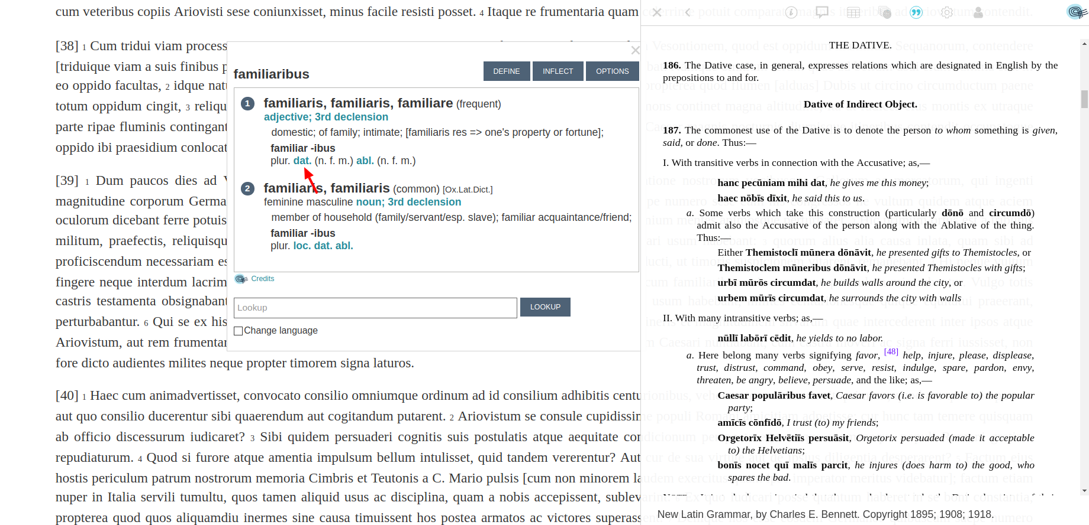
Delve into Grammar

Slide 10
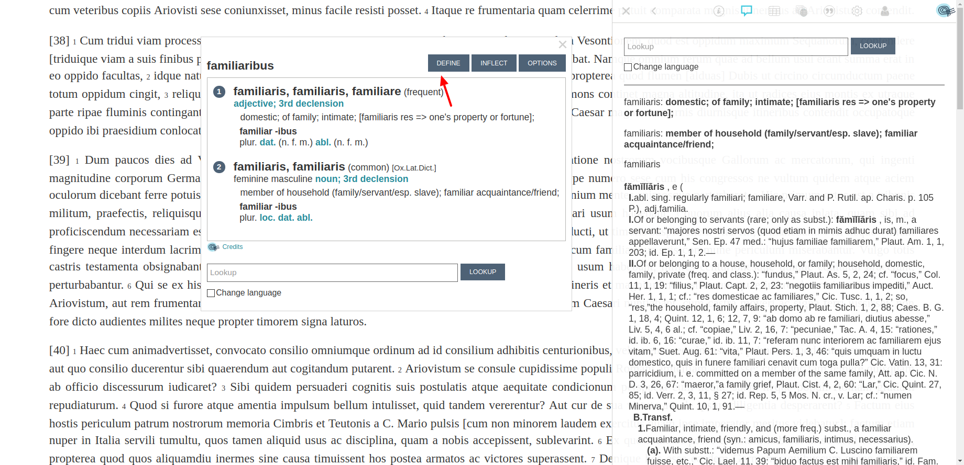
Read Fuller Definitions

Slide 11
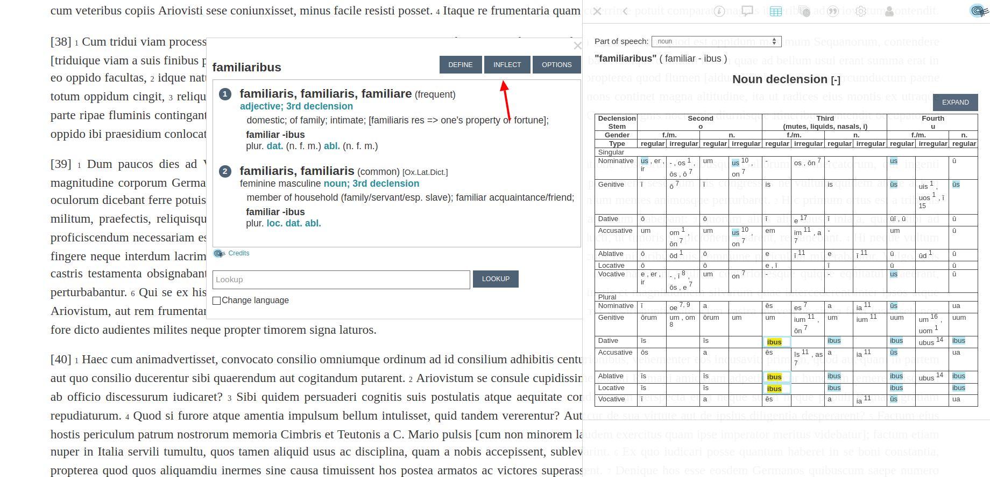
Examine Inflection Tables

Slide 12
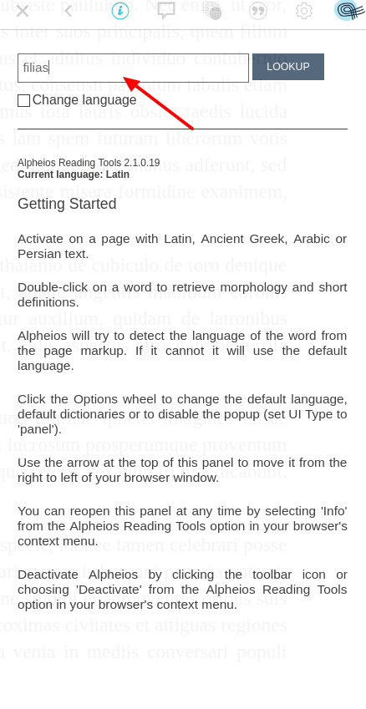
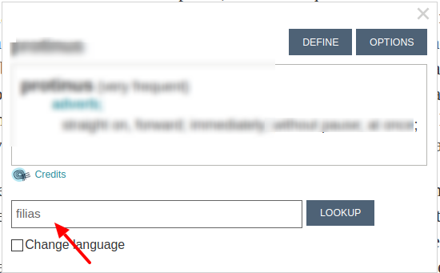
Lookup any word

Slide 13
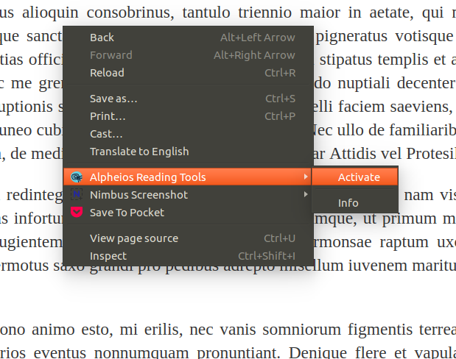
Open Panel Tools

Slide 14
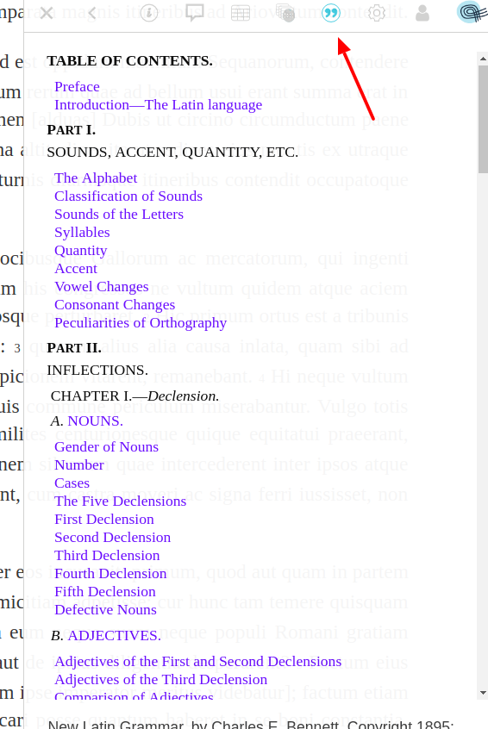
Browse Full Grammar

Slide 15
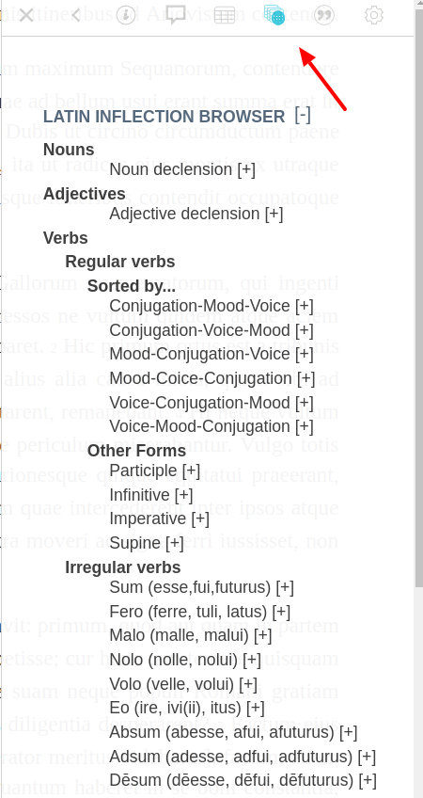
Browse Full Inflection Tables

Slide 16
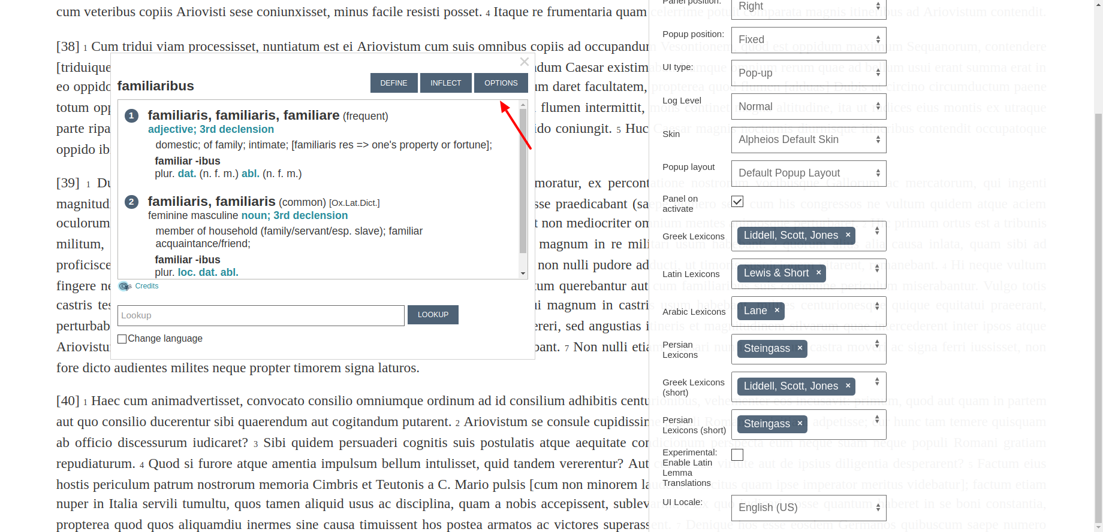
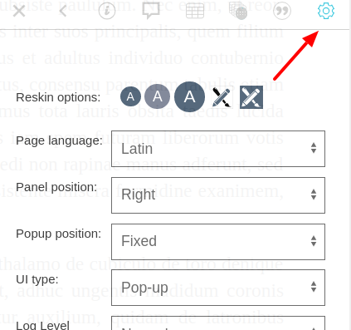
Configure Preferences

Slide 17
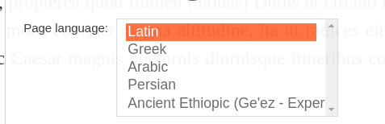
Change Language Defaults

Slide 18
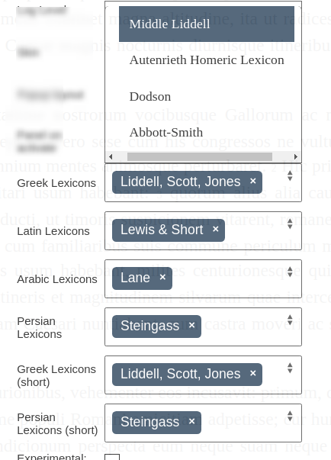
Choose Lexicon(s)

Slide 19
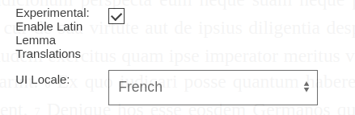
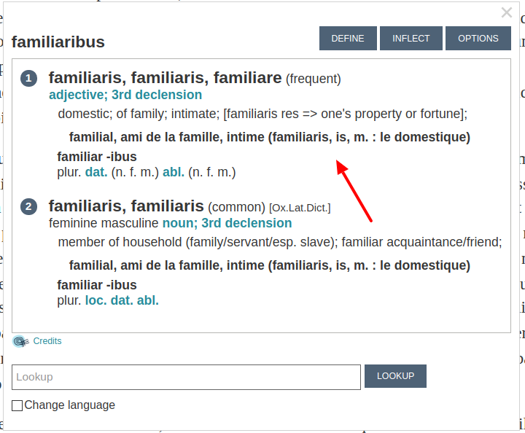
Enable Lemma Translations (Latin, experimental)

Slide 20
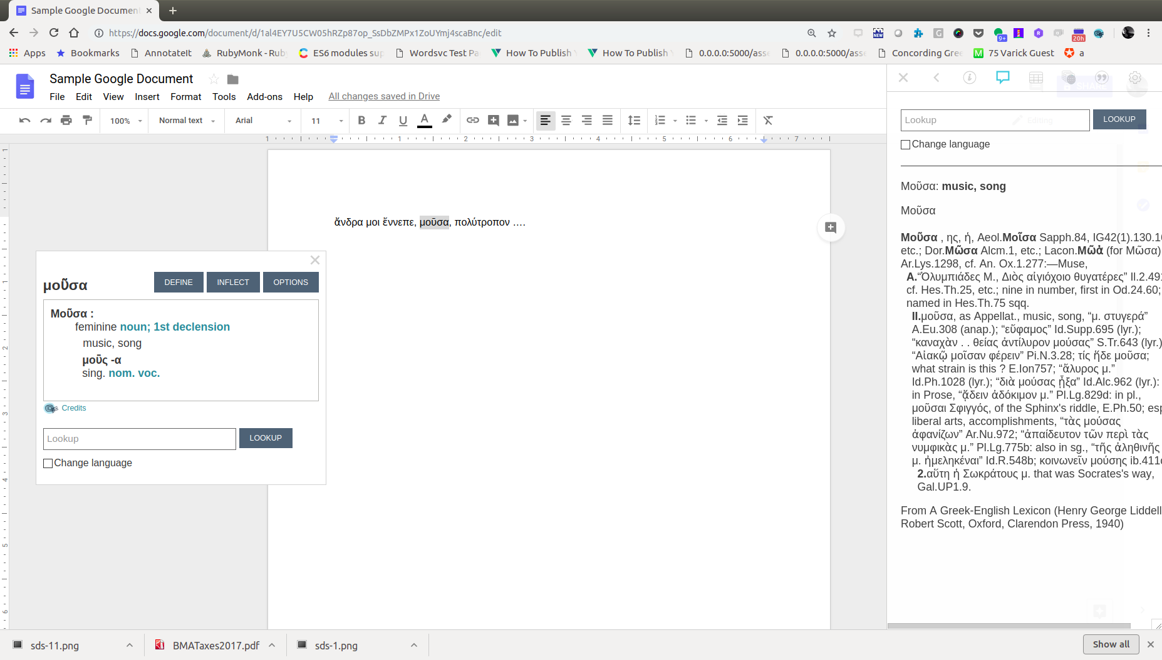
Use with Google Docs

Slide 21
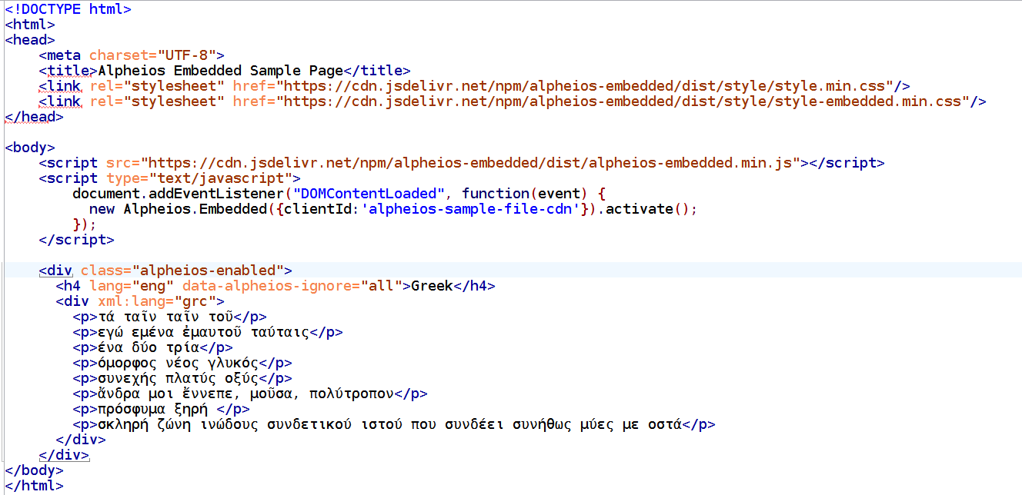
Embed for use with your own site

Slide 22
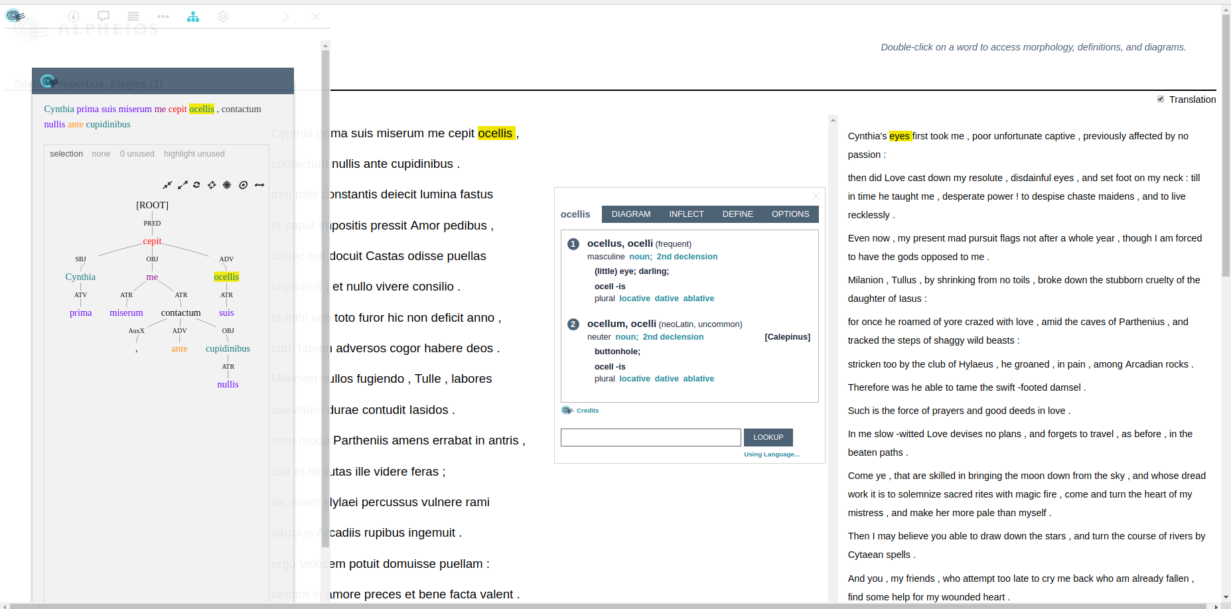
Enhance with Linguistic Annotations

Slide 23
Annotation Integration Requirements
Treebanks
Treebank data aligned at the sentence and word level, adhering to Perseus/Alpheios schema
Using an Arethusa-supported tagset
Accessible via Arethusa and Webservice
Translation Alignments
Word-aligned translation
Alignments embedded in HTML markup
(more information available at https://github.com/alpheios-project/embed-lib)

Slide 24
Example Texts with Integrated Annotations
With Treebanks and Translation Alignments
Homer, Odyssey Book 1
http://alpheios.net/alpheios-texts/Perseus.text.1999.01.0135/book1_card1.html
Propertius, Elegies
http://alpheios.net/alpheios-texts/Perseus.text.1999.02.0066/book1_poem1.html
http://alpheios.net/alpheios-texts/Perseus.text.1999.02.0066/book1_poem2.html
With Treebanks
Various at http://texts.alpheios.net/

Slide 25
Coming Soon
User Wordlists (with context)
Usage Examples (starting with Latin)
Mobile UI (hosted texts)

Slide 26
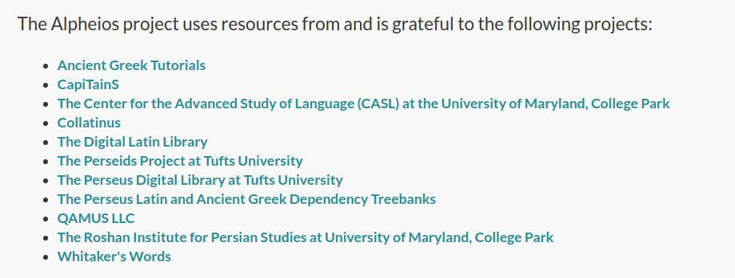

Slide 27
Exercise
Use Alpheios with an unannotated Odyssey
E.g. http://www.hs-augsburg.de/~harsch/graeca/Chronologia/S_ante08/Homeros/hom_od01.html
Select πολύτροπον
Note morphology, definitions, inflections
Use Alpheios an annotated Odyssey
http://alpheios.net/alpheios-texts/Perseus.text.1999.01.0135/book1_card1.html
Select πολύτροπον
Note disambiguated inflection, aligned translation
View sentence diagram

